Slide 1
Simulated Clustering Experimentation
Adam Yang
7/25/2022

Slide 2
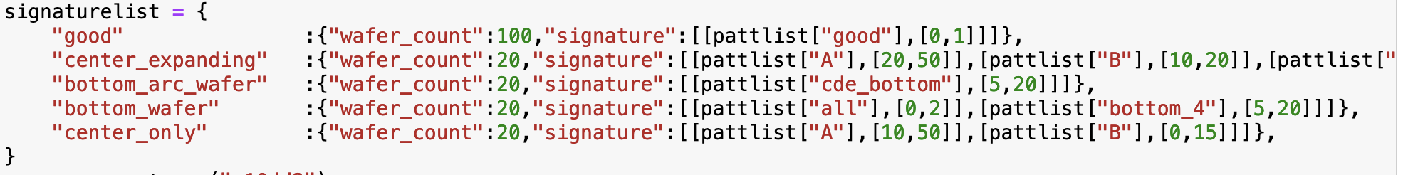
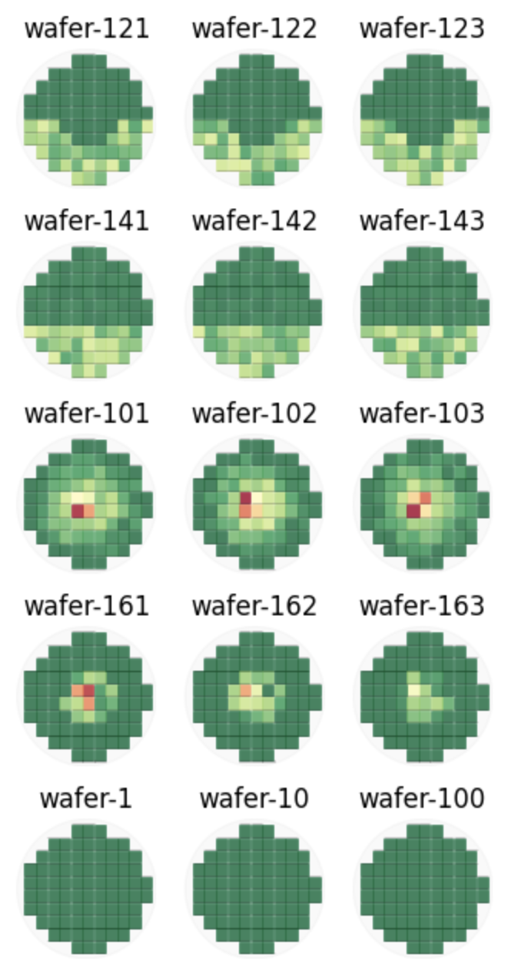
Wafers 121-140 are ”bottom_arc_wafer”
Wafers 141-160 are “bottom_wafer”
Wafers 101-120 are “center_expanding”
Wafers 161-180 are “center_only”
Wafers 1-100 are “good”

Slide 3
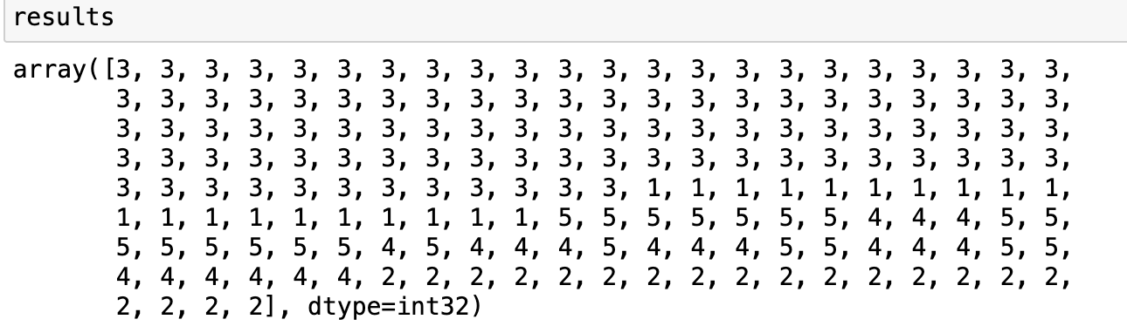
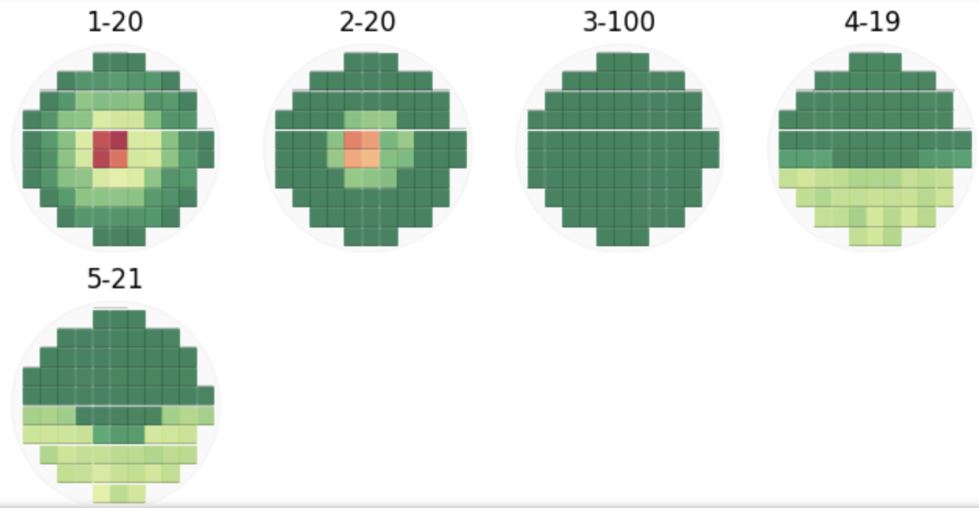
Forcing 5 clusters
First 100 wafers in cluster 3
next 20 in cluster 1
last 20 in cluster 2
Cluster 5 and Cluster 4 are mixed, algorithm having a hard time differentiating “bottom_wafer” and “bottom_arc_wafer”
Stack Map of results (cluster number-Number of wafers)
The algorithm seems to be able to differentiate center only and center expanding but unable to differentiate bottom of the wafer and bottom arc of the wafer signatures.

Slide 4
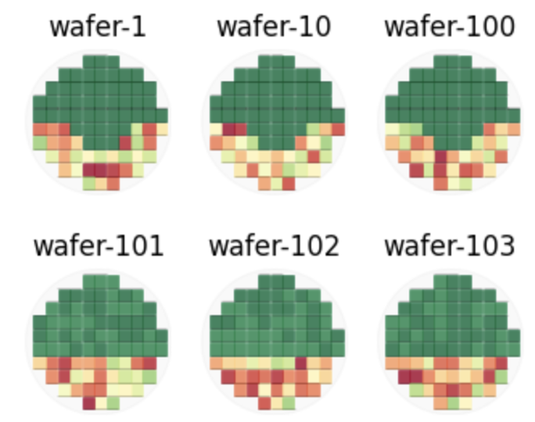
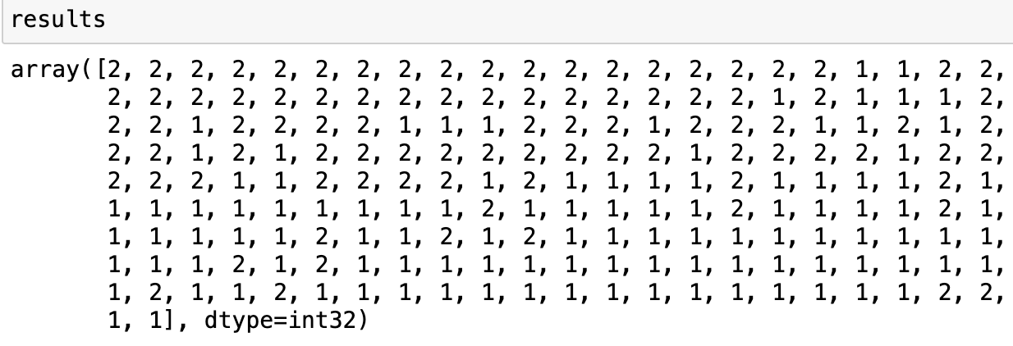
Wafers 1-100 are “wafer_bottom_arc”
78% precision
Wafers 101-200 are “wafer_bottom”
86% precision
Probably dependent on the level of fails on each chip as well, currently we are using a random range of 5 to 20 fails per chip
22 wafer bottom, 78 wafer bottom arc
86 wafer bottom,14 wafer bottom arc

Slide 5
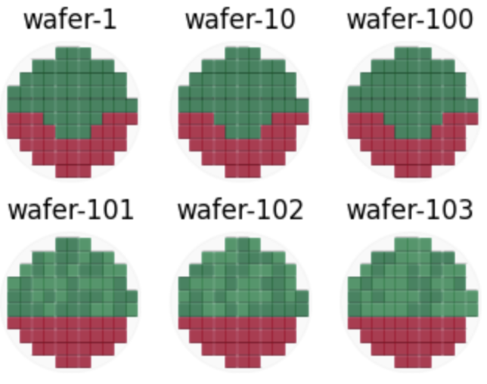
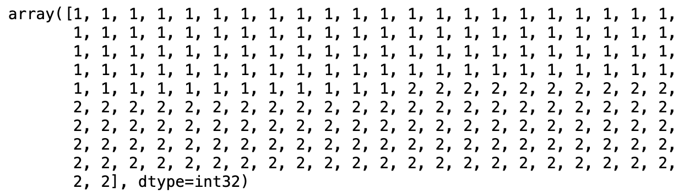
Wafers 1-100 are “wafer_bottom_arc”
100% precision
Wafers 101-200 are “wafer_bottom”
100% precision
As expected, when making every chip have 19-20 fails per chip, there is no more ambiguity between the two groups
0 wafer bottom, 100 wafer bottom arc
100 wafer bottom, 0 wafer bottom arc

Slide 6
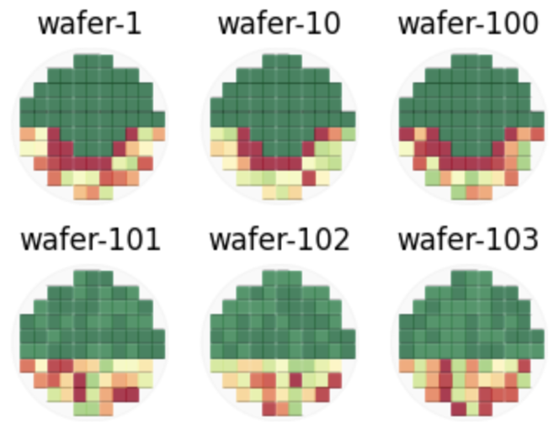
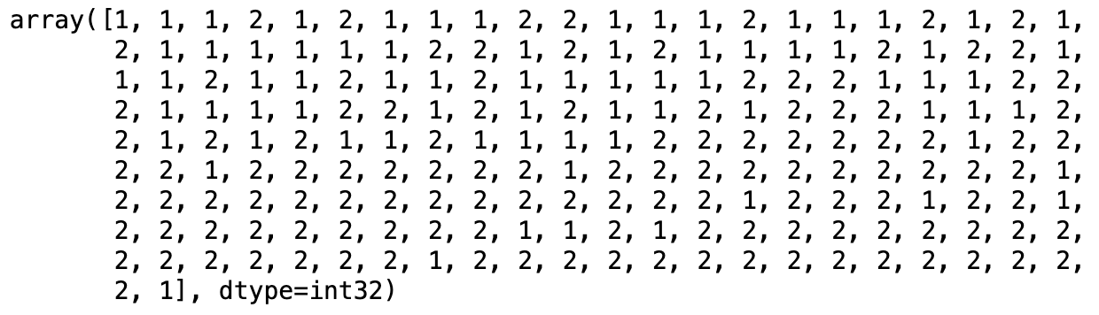
I tried to make the U shape a lot more prominent, and the results were surprisingly worse
63% precision
88% precision
37 wafer bottom, 63 wafer bottom arc
88 wafer bottom, 12 wafer bottom arc

Slide 7
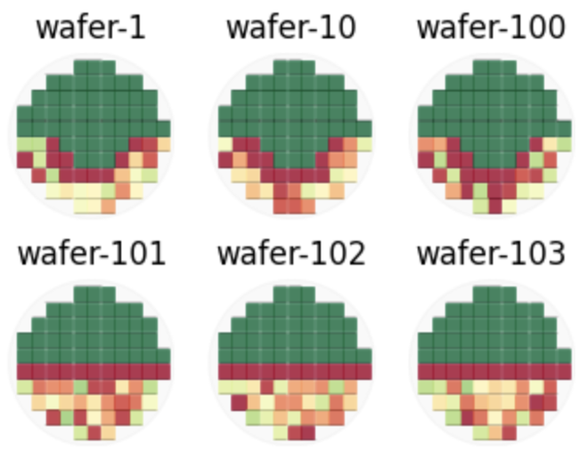
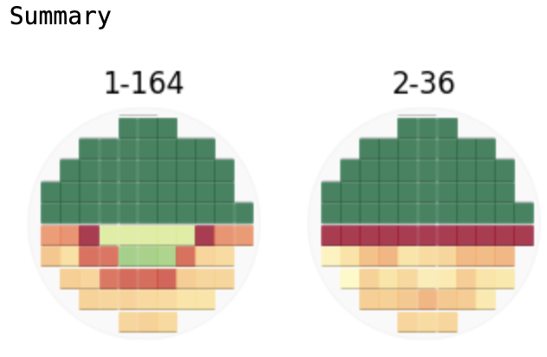
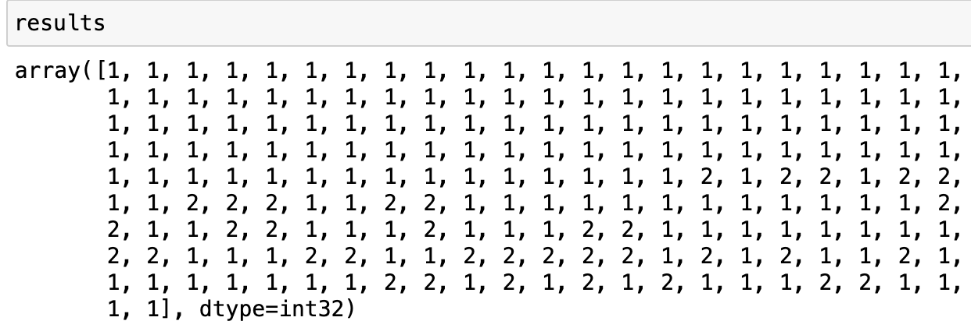
In addition to making the U shape more prominent, I tried making the equator of the second group more prominent too. Surprisingly the second group is now doing much worse.
100% precision
36% precision
0 wafer bottom, 100 wafer bottom arc
36 wafer bottom, 64 wafer bottom arc

Slide 8
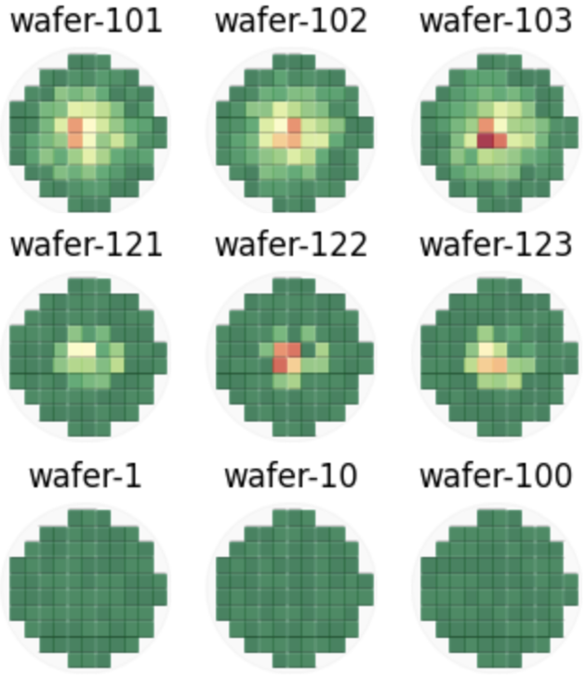
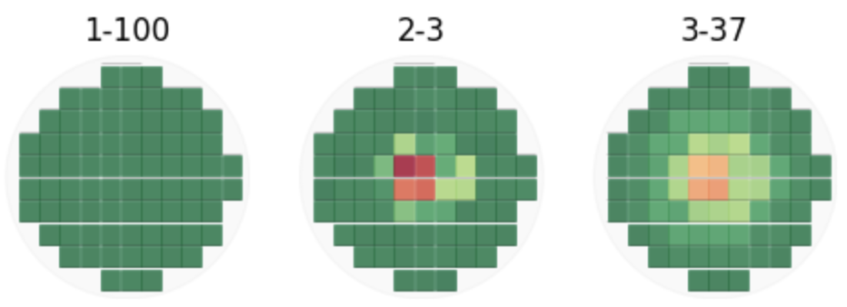
Wafers 100-120 are “Center Expanding”
We observed that wafers without random noise were grouped cleanly into 3 buckets with 100% precision. Now I added random noise of 0,1,2 fails on each chip to see how that affects the result
Wafers 120-140 are “Center"
Wafers 1-100 are “Good”
Cluster number – number of wafers
All 100 “Good wafers” were grouped together, but the remaining wafers had a hard time being differentiated between center and center expanding. If I didn’t force 3 clusters, I think we would’ve seen 2 clusters only.

Slide 9
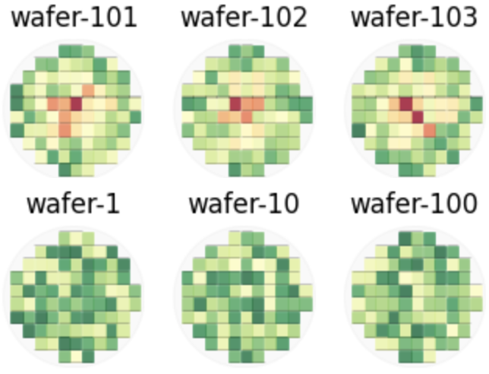
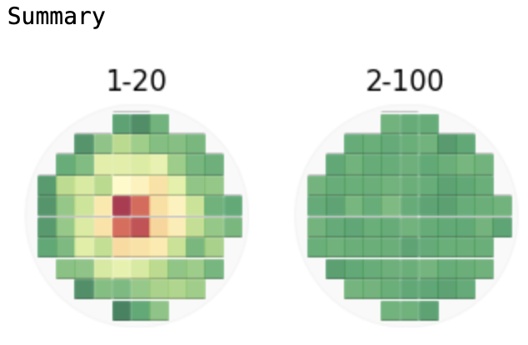
Wafers 100-120: 200 - 300 range, gradually getting hotter in the center of wafer
Wafers 0-100: 200 - 250 range, representing baseline measurements
Results ended up being perfect with all 20 wafers that get hotter in the center being classified into the same group

Slide 10
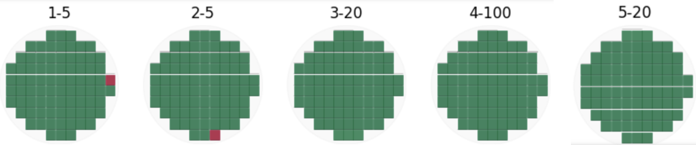
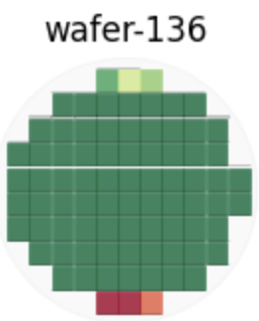
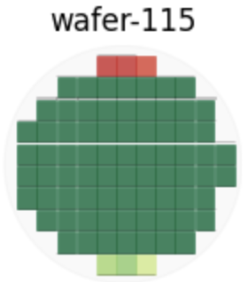
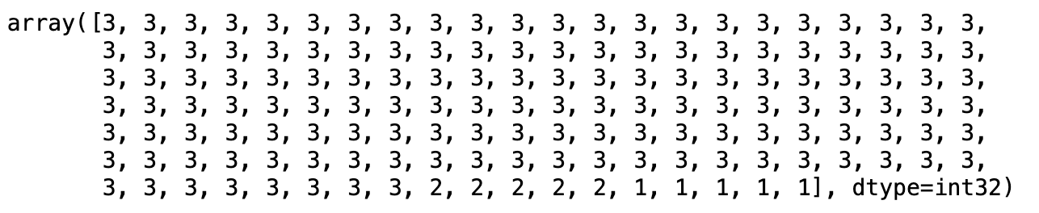
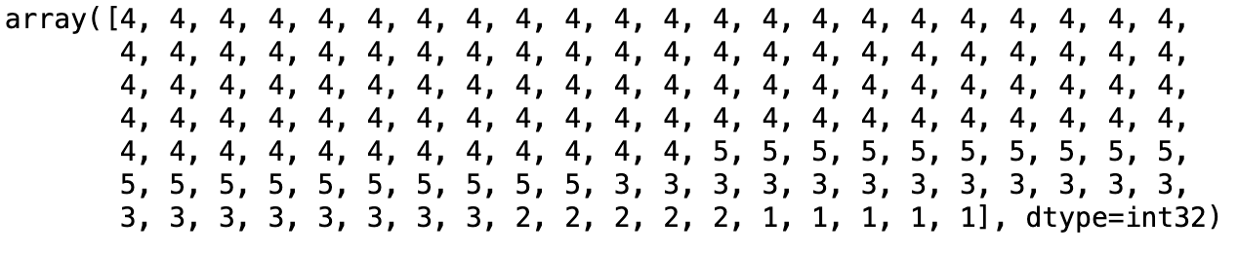
1000 fails
20-25 fails
Test Case: 5 wafers with dense fails at the right most chip, 5 wafers with dense fails at the bottom chip, 20 wafers with top Ghost Fin signal, 20 wafers with bottom Ghost Fin signal, and 100 regular wafers.
However, in regular practice we might set T to 3 because we are only aware of Ghost Fin, In that case, the Ghost Fin wafers were grouped with the clean wafers. Maybe in practice, we would want to normalize chips with large fails or even screen out outlier chips.
If T is set to 5 clusters, the model perfectly arranged each wafer too the appropriate clusters

Slide 11
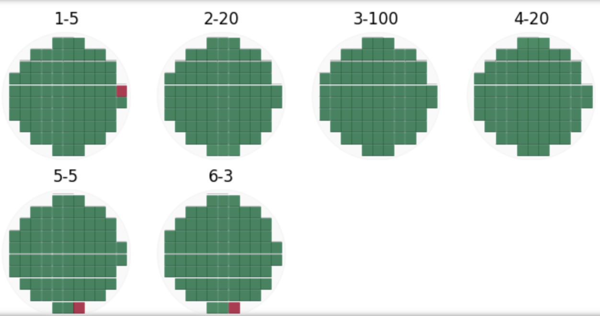
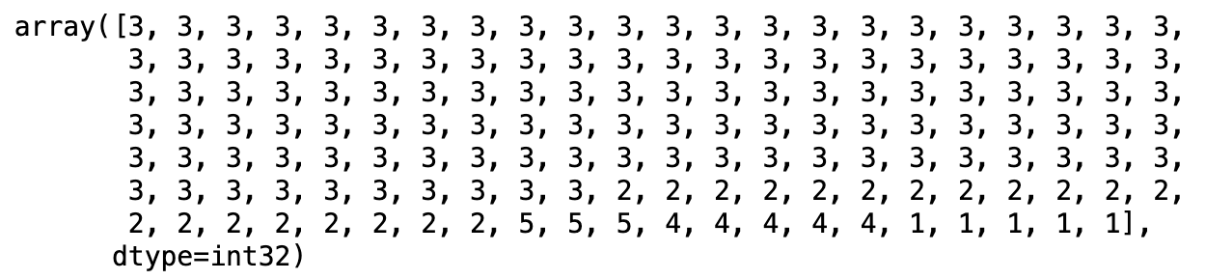

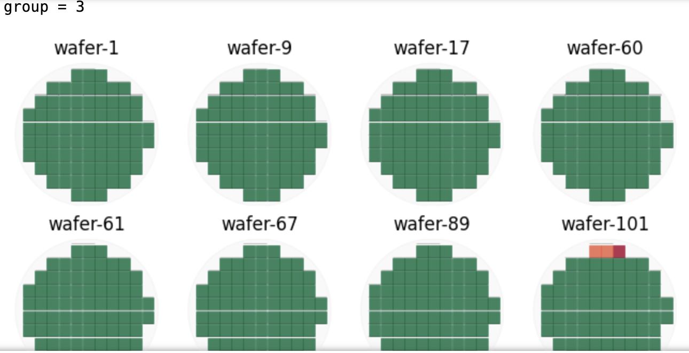
Now I used the same data set as before but added 3 new wafers that had the heavy bottom Ghost Fin but also the bottom chip with high density fails.
If I set T = 5, all wafers are properly clustered except the top Ghost Fin signal gets mixed in with the perfect wafers signal. If I use T = 6, all wafers are properly grouped into their respective groups.

Slide 12
To Dos:
Figure out a way to tell the user how many clusters are optimal
This clustering method has its weaknesses, need to figure out a way to deal with these weaknesses (normalizing high counts, implement alternative clustering methods, etc.)
Hack the OMP (currently using sklearn version) to implement simultaneous OMP which will allow using more than one y variable for clustering
Current version is good enough to be used with input data manipulation and experimentation
Options:
Wrap up function into usable package and distribute for people to play with
People tell Thomas and I what they would want to be clustered, and we do the clustering and report back on insight

